Slide 1
Web Development JavaScript

Slide 2

Ajax

Slide 3
Objectives
In this chapter you'll learn :
How to call APIs using Ajax

Slide 4
What is Ajax
Allows web pages to update without reloading
Communicates with the server in the background
Often used to load or send data
Often as JSON
Why Use AJAX?
Better user experience (no full page reloads)
Faster interaction
Enables dynamic content updates (e.g., news feeds, comments)
Common in Single Page Applications (SPA)

Slide 5
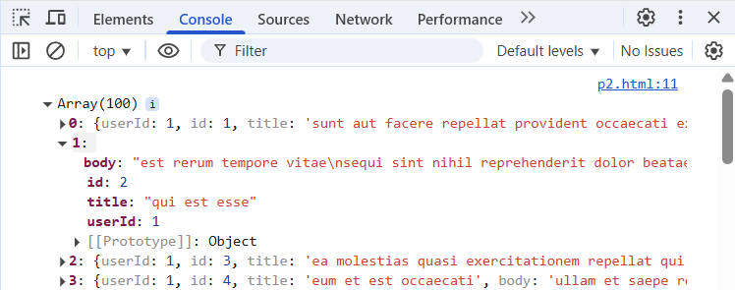
How to make Ajax call using fetch
Modern way to make HTTP requests replaces older XMLHttpRequest
Returns a Promise *
Supports GET, POST, and more
Great for working with JSON APIs
fetch('https://jsonplaceholder.typicode.com/posts')
.then(response => response.json())
.then(data => console.log(data));
A Promise is like a guarantee that something will be done later.
Used when waiting for something, like data from a server.

Slide 6
In this chapter you learned:
How to get data using Ajax
Summary

Slide 7
Lab
Please do the lab for this chapter

